Slide 1
Socket Projects
劉育廷
2023-09-05

Slide 2
Projects
1. UDP Proxy
2. ICMP Sniffer
3. Chatroom
Using C to implement all projects
Description for system design and function scheduling are required on every project

Slide 3
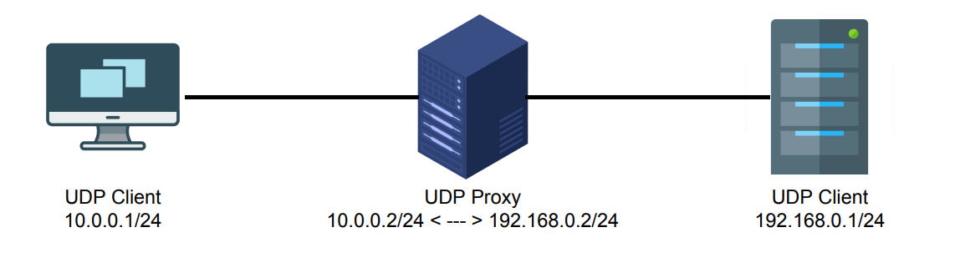
Project – UDP Proxy
Use UDP socket to design a UDP Proxy
Functions:
Payload with ‘aabb’ turn into ‘ccdd’
Payload with ‘eeff’ -> drop
Else forward normally

Slide 4
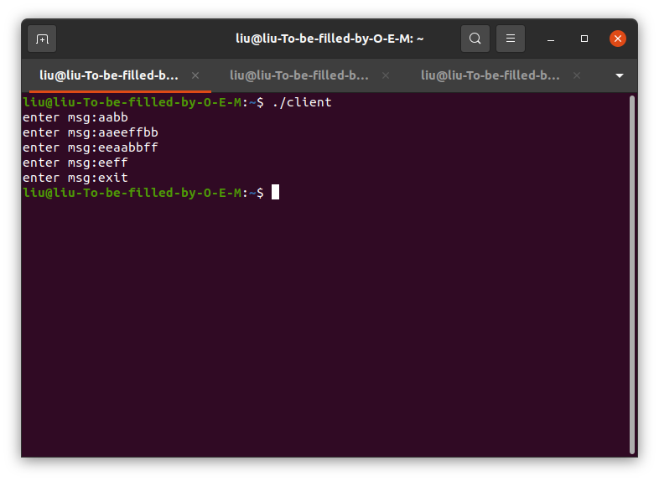
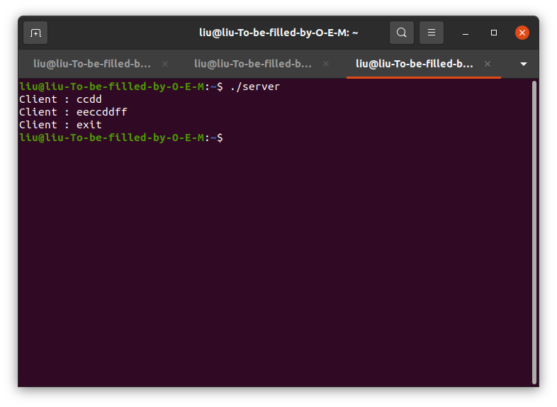
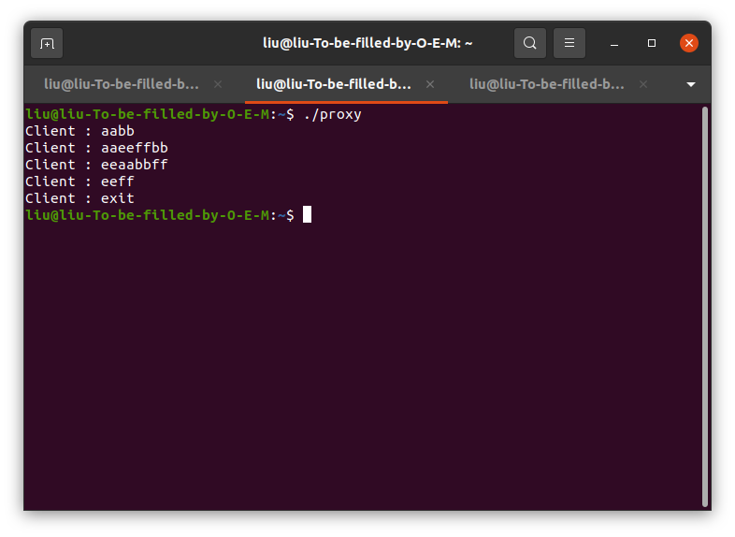
Project – UDP Proxy

Slide 5
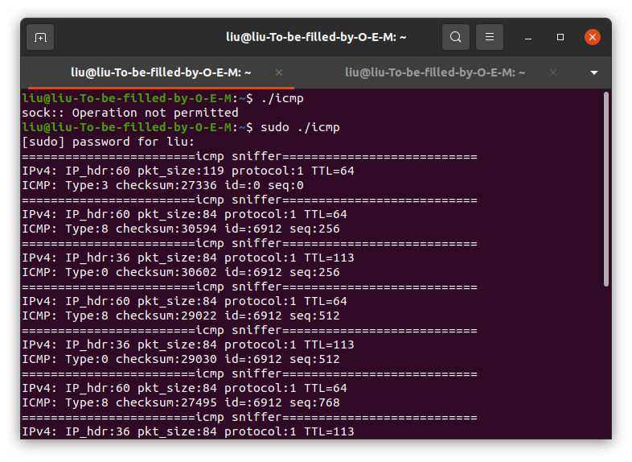
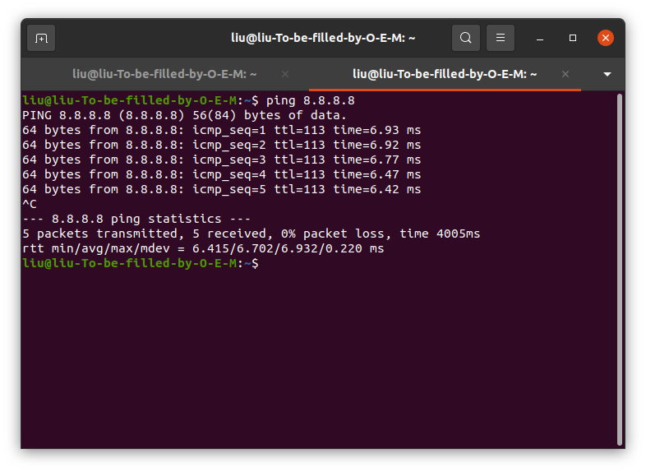
Project – ICMP Sniffer
Sniff ICMP packet payload

Slide 6
Project – Chatroom
Complete a multiple user chatroom in TCP socket
Each user has its own name, group category
Functions:
Allows multiple users to log in and chat at the same time(hint: non-blocking socket)
You can choose to talk to a user, a group or everyone
Record all the message to a documents
(.txt is fine)
(Recording message include time, sender, receiver and content)

Slide 7
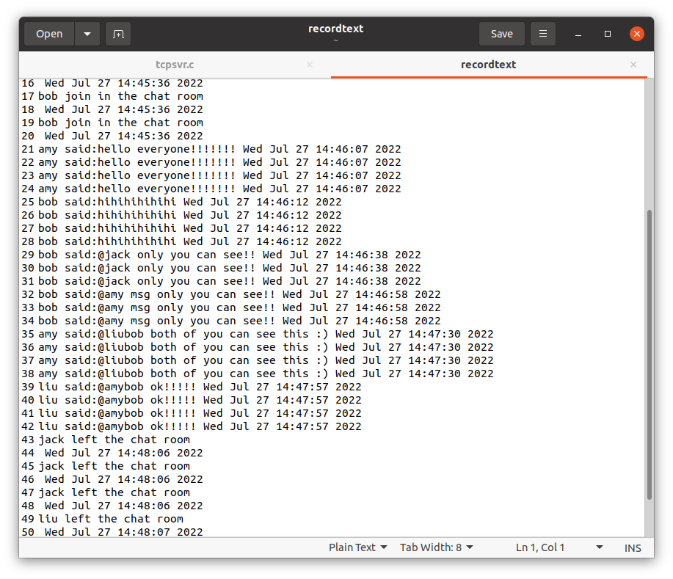
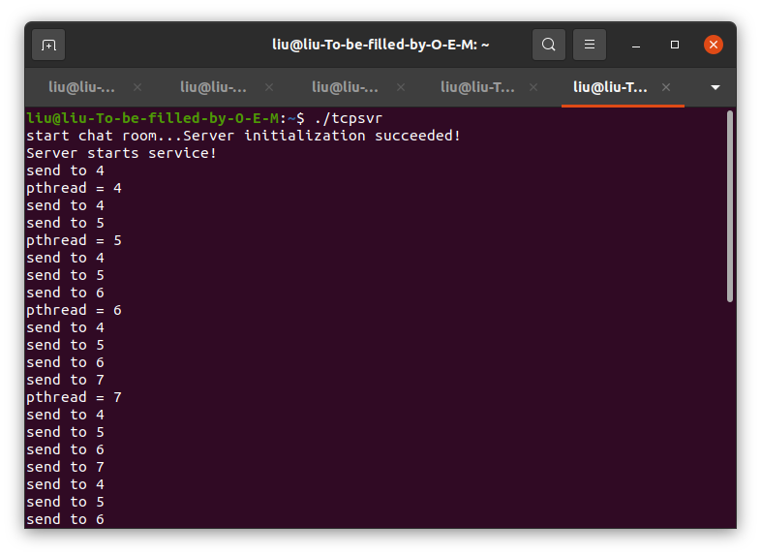
Project – Chatroom
Server

Slide 8
